Slide 1
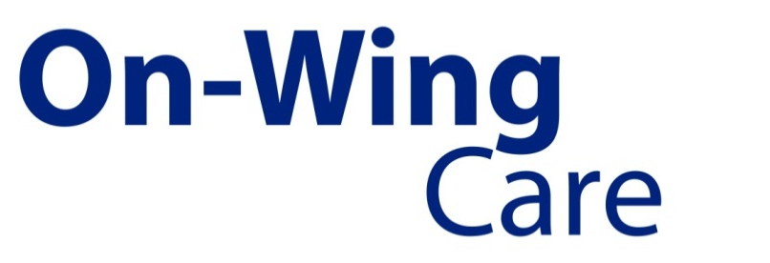
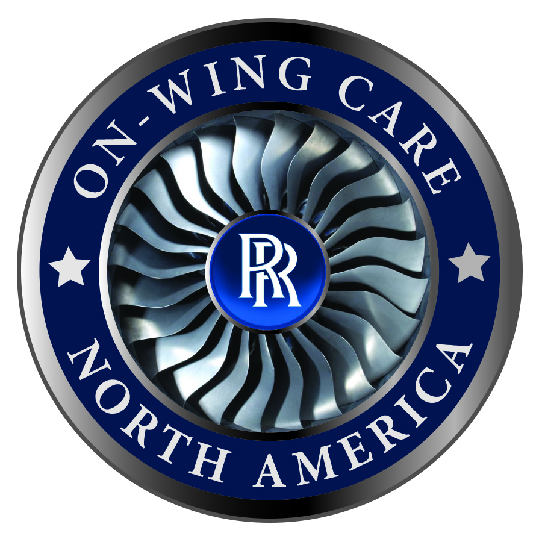

Slide 2
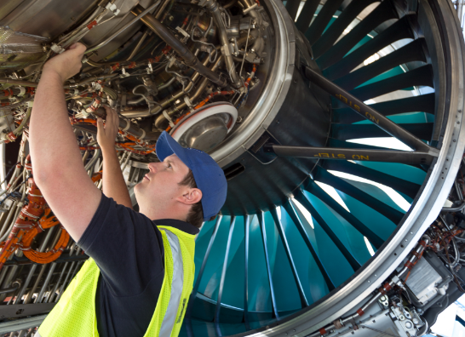
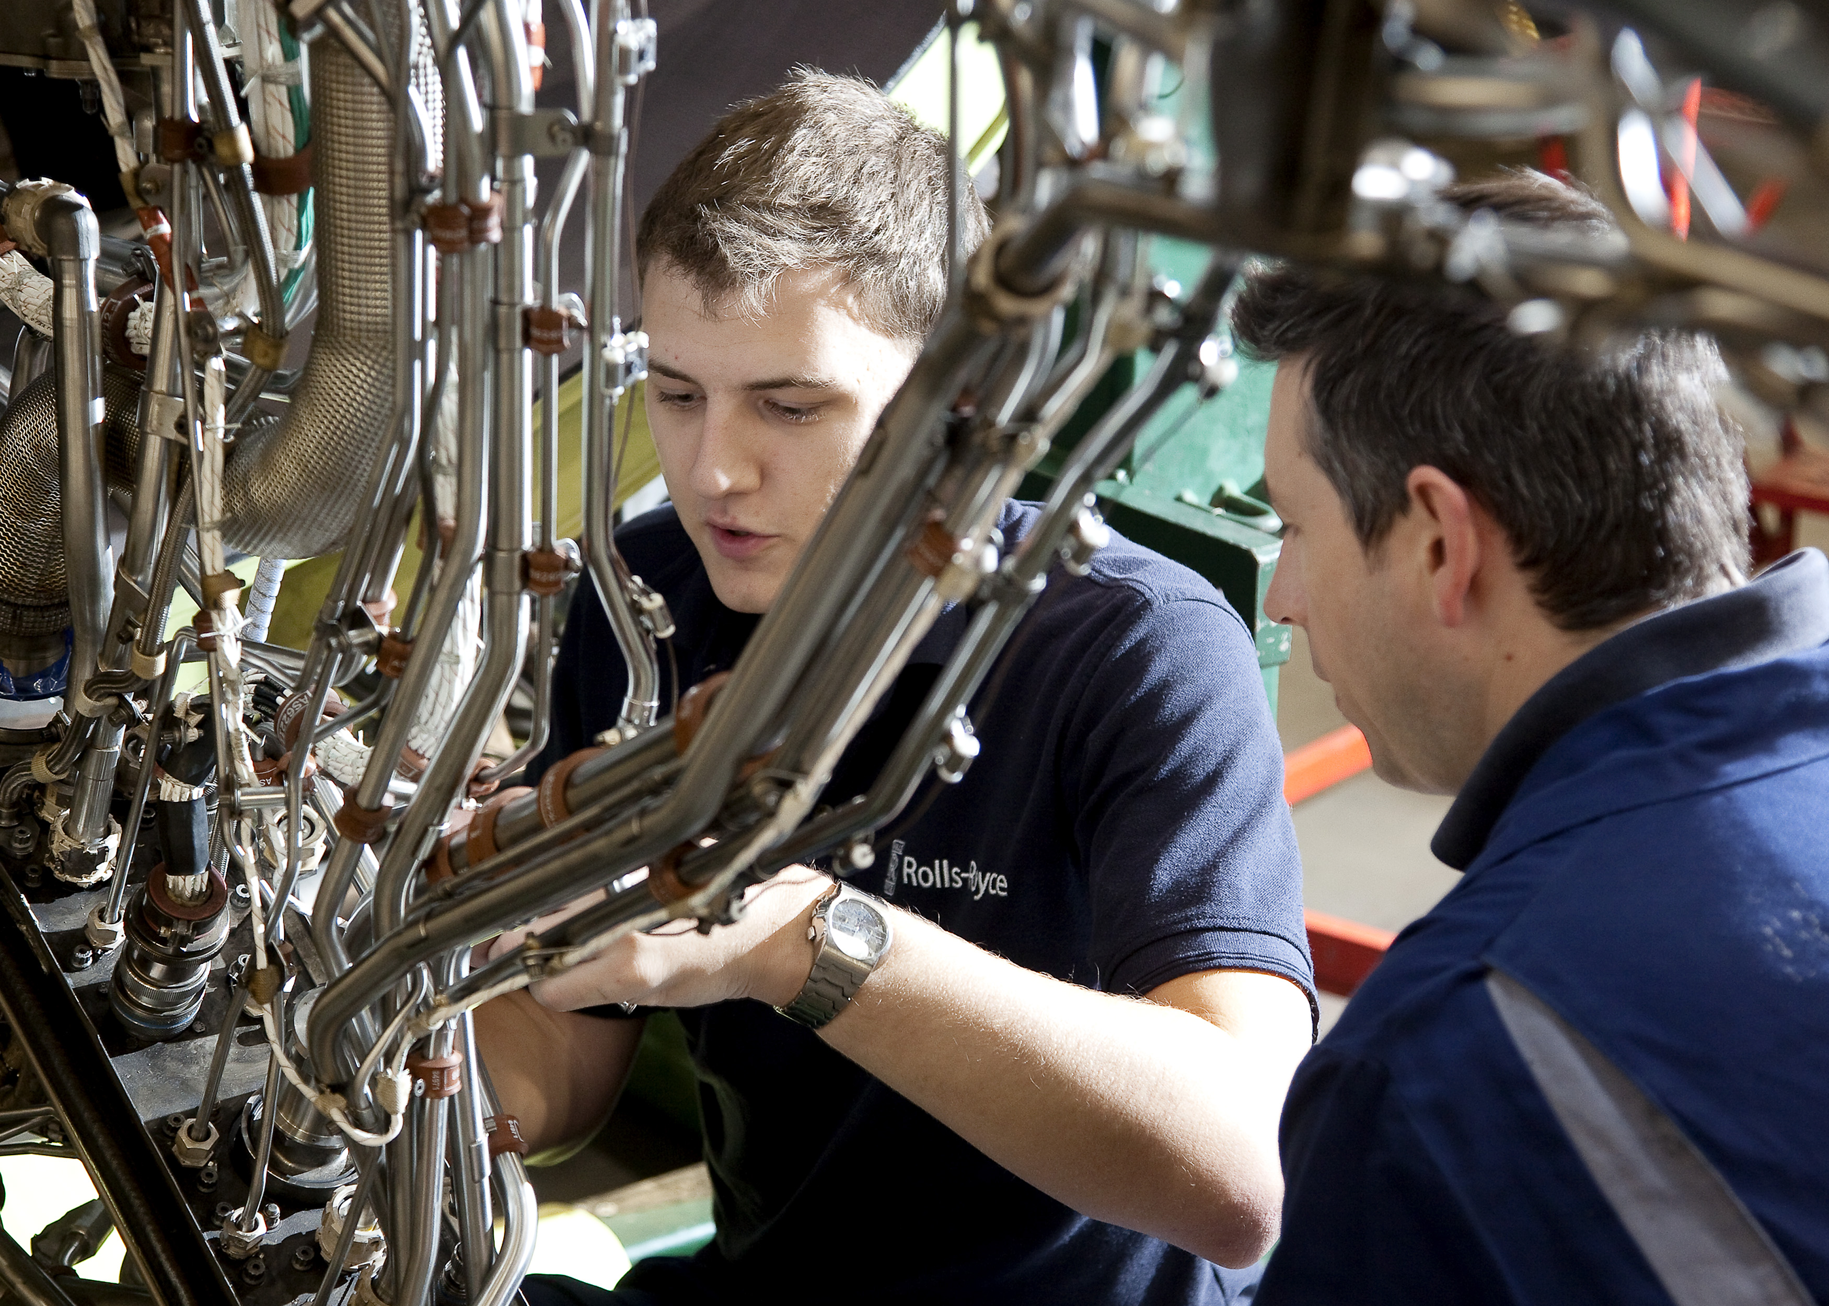
FAR 145 Repair Station
Minimizing operational disruption
Network of over 40 highly trained technicians
Fully mobilized network
Rapid response service
Routine/Non-routine line support
Hospital shop support
Boroscope inspection
Boroblending repairs
Service bulletin implementation
NDT Inspections
Engine and module change
Engine washing (Dependent on local environmental rules)
Non Modular accessory change

Slide 3
Capabilities
capability
Please contact our Maintenance Operation Center (MOC) for any questions regarding our capabilities
Tel: +1 (866) 230 6942 E-mail: OWCNA@Rolls-Royce.com

Slide 4



North American Locations
Main Facility
Technician Locations

Slide 5

International Locations
Technician Locations

Slide 6

Airworthiness Locations/ Sign offs Sign Offs
EASA
FAA
CAAC
Cayman Island
Sign Offs
FAA 8130
FAA 8130/EASA Dual Release
CAAC AAC-038
Certificate of Conformance
Log Book Entry
OTAR 145 approval for Cayman Islands

Slide 7
Maintenance Operation
Center
To schedule work or inquire about our services, please contact our Maintenance Operation Center (MOC):
Rolls-Royce On-Wing Care North America
2135 Hoffman Road
Indianapolis, IN 46241
Tel: +1 (866) 230 6942
E-mail: OWCNA@Rolls-Royce.com
Work Request Form

Slide 8
